Slide 1


Exploration of Numerical Precision in Deep Neural Networks
Zhaoqi Li, Yu Ma, Catalina Vajiac, Yunkai Zhang
Industry Mentors: Nicholas Malaya, Allen Rush
Academic Mentor: Hangjie Ji
Research in Industrial Projects for Students (RIPS) 2017

Slide 2

Overview
Introduction
Background
Motivation
Goals
Method
Arbitrary Precision
Mixed Precision
Quantization
Future Work

Slide 3
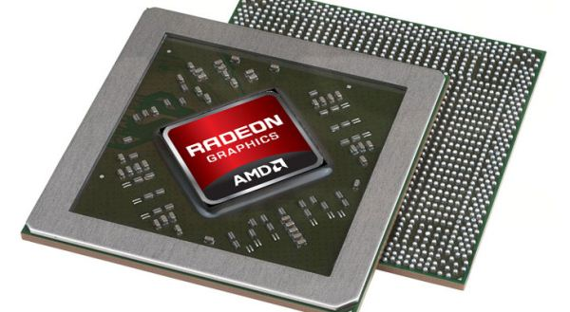
AMD - The Company
Semiconductor company
Circuit design & computer architecture
Interested in performance of algorithms
Notes:
A company that makes/designs hardware - computer chips, game consoles, cloud servers
Work for their research team, who is, not just interested in hardware, interested in computing in general - from circuit design to computer architecture - contribution to the future of computing
Advanced Micro Devices, Inc. (AMD) is a semiconductor company designing and integrating technology that powers millions of intelligent devices, including personal computers, game consoles and cloud servers that define the future of computing. AMD's research team develops methods and products in many cutting-edge fields that lead to critical advances for not only the company, but computing in general. Its diverse research areas range from circuit design and computer architecture to system software and application engineering. The overarching goal of the company is to influence both industry and academia through exploration of research directions and future technologies in an environment conducive to collaborations with groups within and outside AMD.

Slide 4
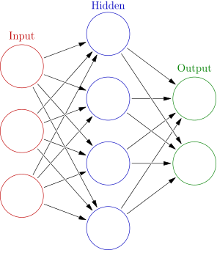
Convolutional Neural Network
What is a neural network?
Motivated by human brain
Convolutional: sparsely-connected
Avoid waste of unnecessary interactions between units
Notes:
Neural network: a type of network that looks like, the human’s brain
Take an example of describing a blackboard - input (eyes, black, square, …), hidden, output (blackboard)

Slide 5
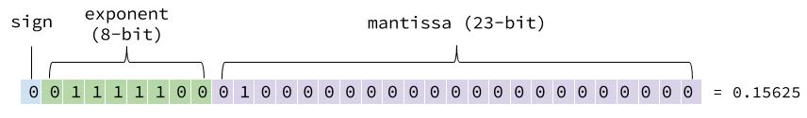
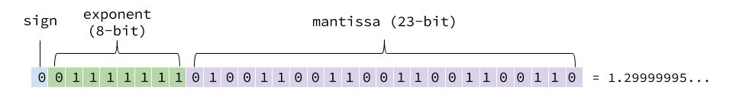
Numerical Representation in Memory
x = ±1.mantissa * 2^{exponent}
1.3?
Notes:
Computer can only store 0 / 1, how can it store decimal numbers?
develop standard, popular: FPF - scientific notation
Sign bit: 0 - positive; 1 - negative
Ex.
Representation error, large if low prec, low if high prec
Neural network: don’t need high prec

Slide 6
Motivation for Reduced Precision
Memory-bound systems
Neural networks for simple devices (i.e. mobile)
GPUs
Overhead for transferring data from CPU to GPU
Good for performing many small tasks in parallel
Distributed ML Algorithms
Notes:
Reduce precision -> reduce data needs to be stored
- For mobile devices, which have limited amount of memory, by reducing data we can store more info
- For GPU, we can reduce the amount of data transferring between machines, thus good for performing small tasks in parallel
- For distributed algorithms, where many machines interact with parameter server, less precision means that less bits to be transferred between machines - fast the alg
DL: multiple machine runs on the same network -> needs communication -> …

Slide 7
Previous Work
Reduced precision works for inference (Gupta, et al. 2015)
Low precision works for the training process (Courbariaux, et al. 2014)
Intel supports half precision, Google supports 8-bit arithmetic

Slide 8
Goals
Gain understanding of
Deep Neural Networks (DNNs)
Numerical representations in memory
Computer arithmetic
Optimize deep learning performance with low precision
Precision/stability vs. memory/speed
Estimate precision bounds for particular networks

Slide 9
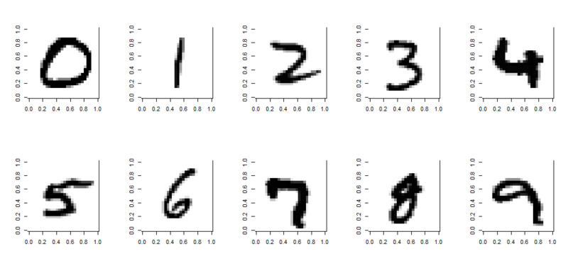
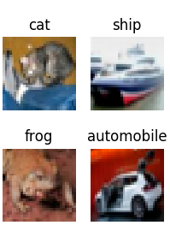
Arbitrary Precision: Introduction
Represent a number with any number of bits
Software:
Tensorflow: black boxed functions
CAFFE: only supports float 32
Theano: more transparent than the rest
Datasets:
MNIST (digit recognition)
CIFAR10 (object classification)
Notes:
Catalina starts
32 bits - single precision

Slide 10
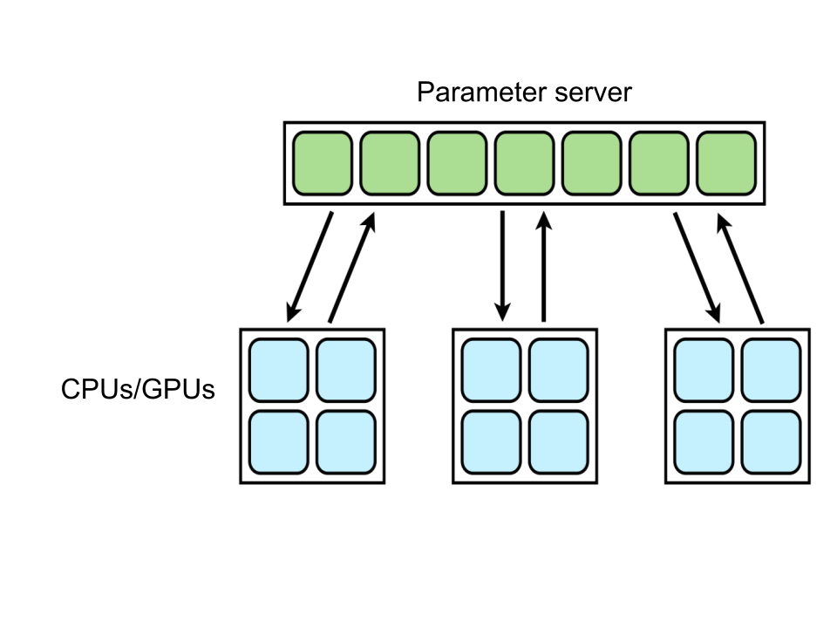
Arbitrary Precision: Truncation
Different levels of truncation:
After each basic arithmetic operation
Emulates hardware-like setting where nothing can be done with higher precision
Complicated: need to redefine Theano functions
After each batch
Represents parameter server for distributed ML algorithms
Not necessary to redefine Theano functions

Slide 11
Arbitrary Precision: Implementation
How to truncate:
Create filter
Bitwise AND with original number
0 0111 1111 1111 1100 1100 1100 1100 110 1.9875
&
1 1111 1111 1111 1110 0000 0000 0000 000 16-bit filter
----------------------------------------
0 0111 1111 1111 1100 0000 0000 0000 000 1.984375

Slide 12
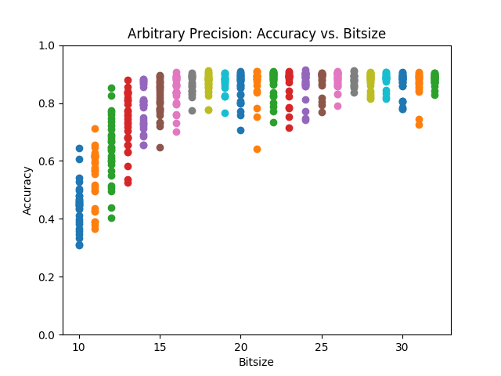
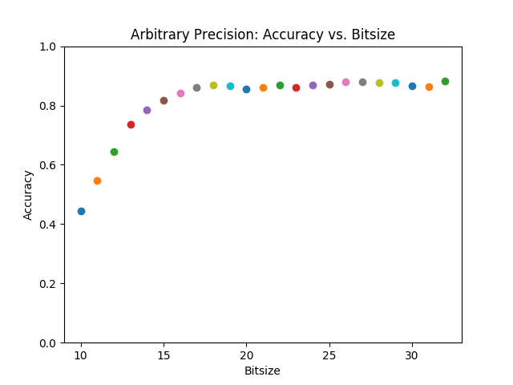
Arbitrary Precision: Logistic Regression Results
Notes:
Using round-to-nearest, not stochastic rounding
Theano + matplotlib
30 trials per bitsize, 1000 iterations

Slide 13
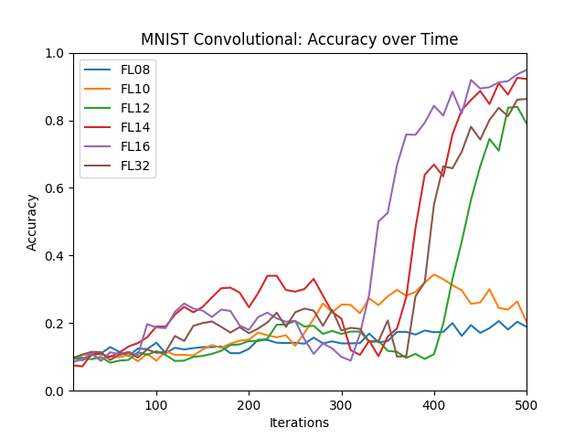
Arbitrary Precision: CNN Results
Notes:
Catalina ends
Using round-to-nearest, not stochastic rounding
Theano + matplotlib
One trial, 500 iterations

Slide 14
Mixed Precision
Change precision after a certain number of iterations
Could happen multiple times per several epochs/batches
Current direction: low to high
The Hypothesis
High precision determines the better local minima to approach
Low precision speeds up the convergence process
Notes:
Another method which we experimented with was mixed precision, where we achieved the goal of reducing precision by changing precision after a certain number of iterations. This process could happen multiple times as (?) we repeat it per batch or per layer. The current direction of precision goes from high to low, where we attempted and investigated the results of float64 to float32, float32 to float16. The result shows that float64 to float32 exhibit very similar accuracy with the optimal accuracy. While float32 to float16 demonstrates a significant accuracy decline. We hypothesize the reason behind this result was due to the sfact that high precision determines the better local minima to approach, while low precision speeds up the process of convergence, which means, high precision more precisely direct us to the route towards optimal accuracy, while low precision allows us to reach it with faster speed.

Slide 15
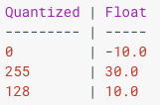
Quantization - Introduction
Google TPU contains 256 x 256 8bit multiply-add computational units
Google low precision GEMM library
Reduce computational resources
Theano based code by Matthieu Courbariaux
Notes:
The last method we experimented with was quantization. The idea behind it is that, since we know almost all of the space taken up by neural network is consist of the weights for neural connections, we could shrink the file sizes by storing the min and max for each layer of the network, and then compress each weight value, which is a float number, to an n-bit integer representing the closest real number in a linear set of 2^n within that range. The picture here shows the quantization process within a layer. We first select the min and max of the input float numbers, and then quantize these numbers to, in this case, 8-bit integers and run them through every similarly quantized operation such as the activation Relu function. At the end, we return them back to float values as output.
The two methods of quantization we investigated were binarynet and 8-bit integer representation, both of which were invented by Matthieu Courbariaux. binaryNet is a more extreme version of quantization, where the quantized values were restricted to only -1 and 1. Though surprisingly simple, it achieved benchmark performance on MNIST, CIFAR-10 and SVHN according to literature. However, we were a bit sceptical of its general application to other tasks other than image classification, and thus did not proceeded investigating it in depth. The 8-bit CNN version quantized the input, weight and output gradient for each layer to N-bit integers, where N was determined by numpy datatype uint8,16,32, and 64. It achieved a 99.07% accuracy for the MNIST dataset and was the main thing we experimented with.
(0.96% 2.80% 11.40% )

Slide 16
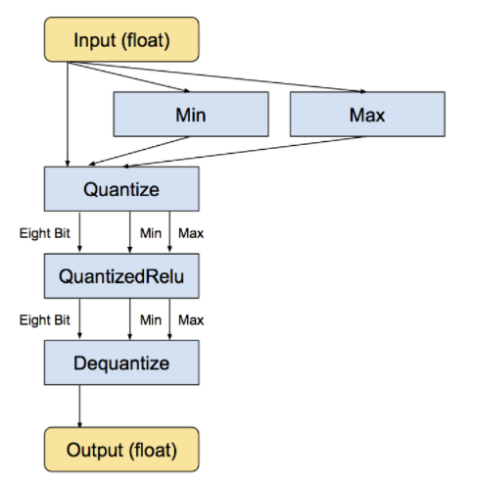
Quantization - Implementation
BinaryNet (quantize to -1 and 1)
Benchmark performance on MNIST, CIFAR-10 and SVHN
8-bit CNN
Quantize input, weight, and output gradient
Difficult to customize arbitrary uint datatype
Nvidia GPU, Theano configuration for CUDA, Lasagne
Fast compilation and fast convergence
Notes:
As mentioned in the previous slide, the 8-bit code uses numpy datatype unsigned integers to implement its 8-bit integer quantization, this significantly restricted our choices of length of bits as it requires us to modify many basic C source code and theano library code to implement our own arbitrary n-bit unsigned integer.
A crucial benefit for us in the future was that this implementation also uses Nvidia GPU to speed up its compilation and convergence. If we attempt to train larger and more complex dataset other than MNIST and CIFAR-10, this will definitely come into use.
However, one thing to be noted of the backslash of using GPUs was that it usually is relatively restricted to using only float32
‘Uint8’: 35s/epoch, 61 epochs, error rate converges to 99.07%

Slide 17
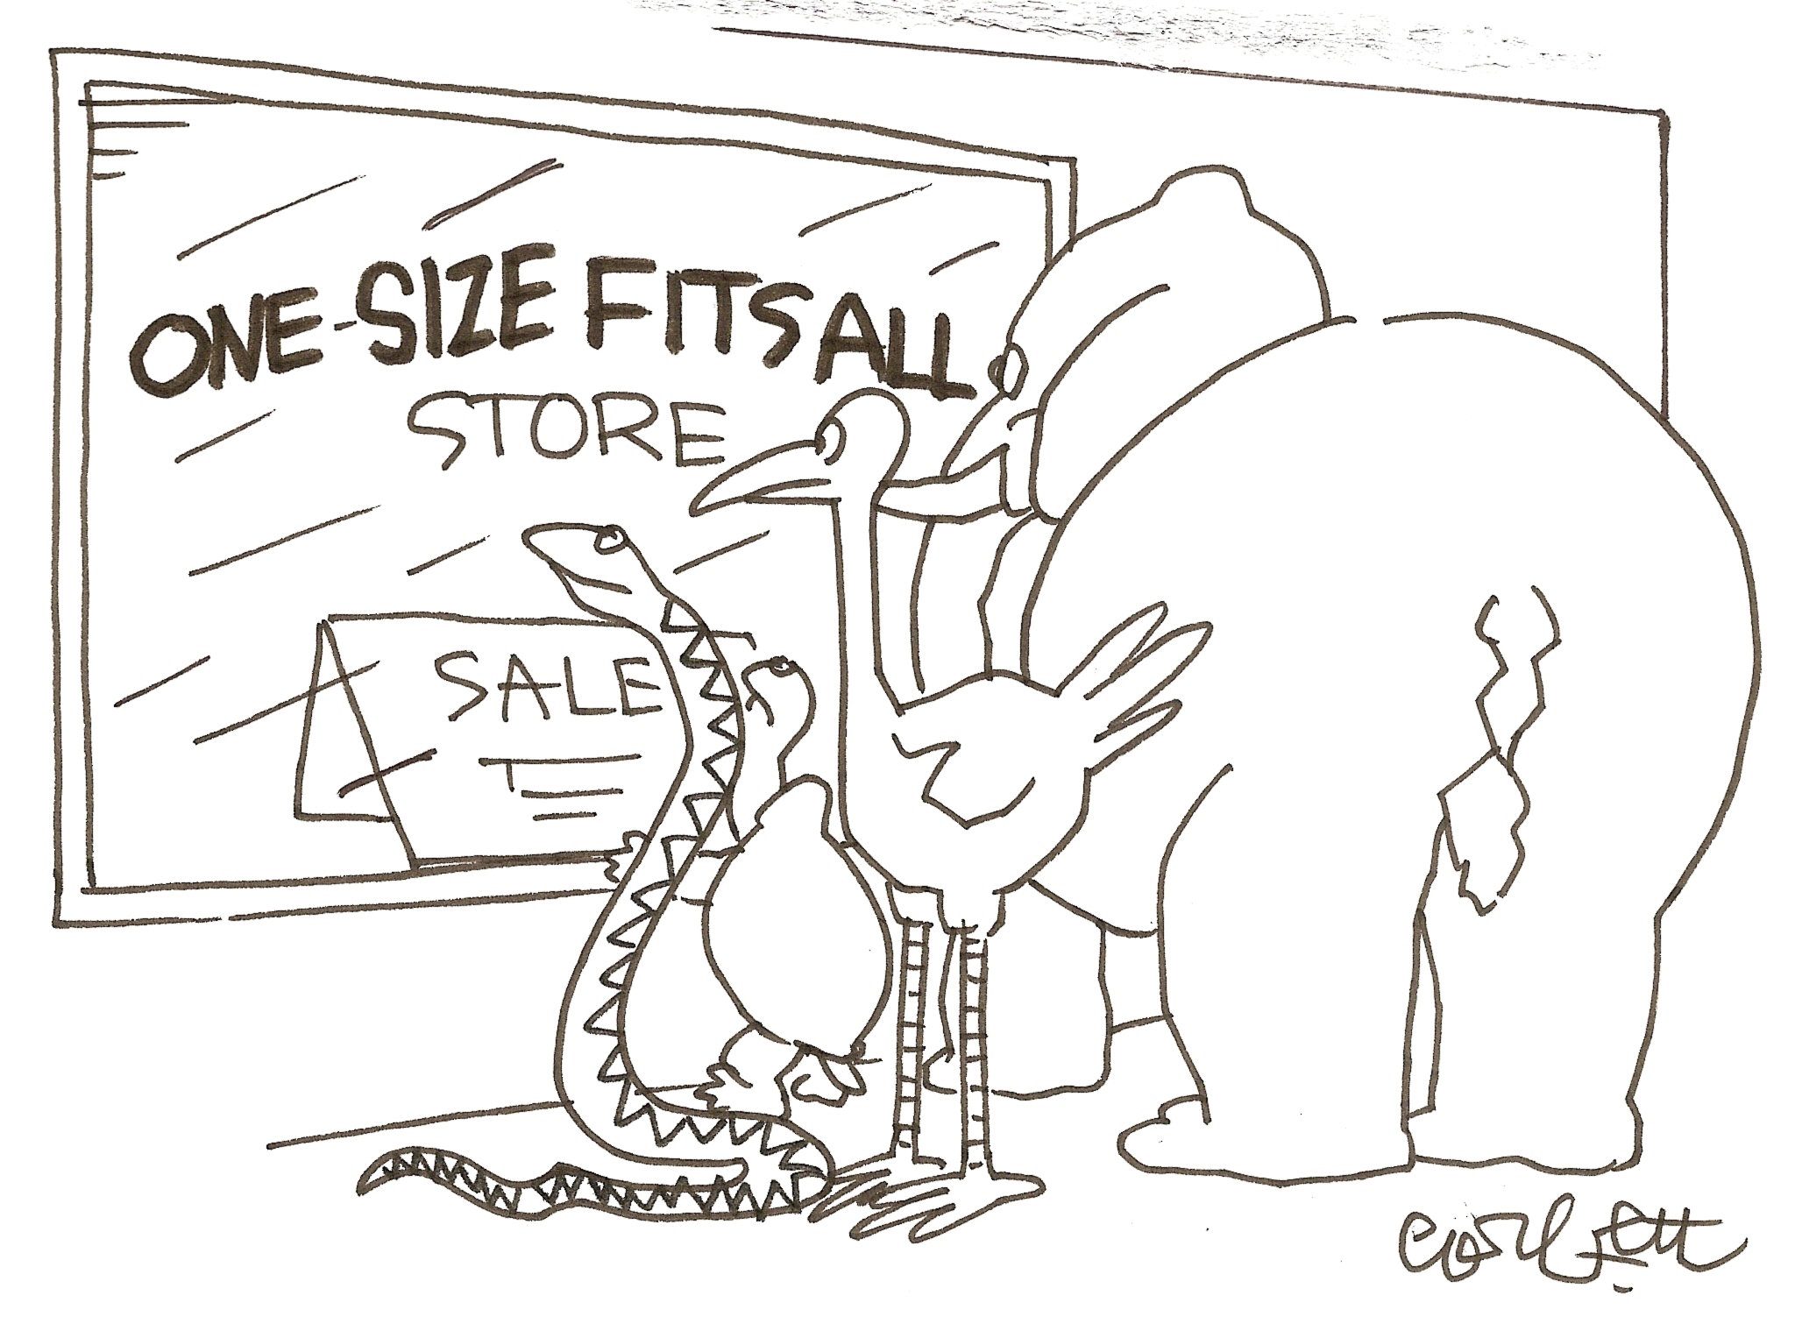
Next Step I
One model for all - # of layers/neurons vs runtime - accumulation error?
Truncation after each layer - need to feed data first - automatic differentiation
Notes:
CL1CK T0 4DD SP34K3R N0T3S

Slide 18
Next Step II
Python Code
1. y = T.nnet.softmax(T.dot(x, W) + b)
2. cross_entropy = -T.sum(y_*T.log(y))
3. g_W = T.grad(cost=cross_entropy, wrt=W)
g_b = T.grad(cost=cross_entropy, wrt=b)
4. updates = [(W, W - learning_rate * g_W), (b, b-learning_rate * g_b)]
5. train_model = theano.function(inputs=[x, y_], outputs=cross_entropy, updates=updates)
Human Language
1. y = xW + b
2. Cost function = ∑(y_*T.log(y))
3. Differentiate cost function with respect to w and b
4. Update W = W - learning_rate * g_W, b = b-learning_rate * g_b
5. Define train_model that takes x, y_ as inputs, find the cost function, and update w and b correspondingly.

Slide 19
Next Step II
Processed Using Symbols
y = T.nnet.softmax(T.dot(x, W) + b)
cross_entropy = -T.sum(y_*T.log(y))
g_W = T.grad(cost=cross_entropy, wrt=W)
g_b = T.grad(cost=cross_entropy, wrt=b)
updates = [(W, W - learning_rate * g_W), (b, b - learning_rate * g_b)]
train_model = theano.function(inputs=[x, y_], outputs=cross_entropy, updates=updates)
#Y = xW+b
#gradient
Want to change to numbers to truncate

Slide 20
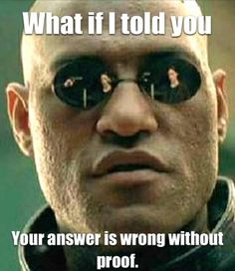
Finally...
“Prove” it!

Slide 21
Thank you for your attention!
Questions?

Slide 22
References
[1] Gupta, Suyog, et al. “Deep Learning with Limited Numerical Precision." ICML. 2015.
[2] Goodfellow, Ian, Yoshua Bengio, and Aaron Courville. Deep learning. MIT press, 2016.
[3] Courbariaux, Matthieu, Yoshua Bengio, and Jean-Pierre David. "Training deep neural networks with low precision multiplications." arXiv preprint arXiv:1412.7024 (2014).

